Slide 1
Manage Contact History Workshop A-1 Jose Diaz and Mohanta Das 6/23/26

Slide 2





Overarching Design Principles
The goal of this project is to utilize standard Service Cloud V2 capabilities with minimal customizations. We will strive to modify our processes to Fit-to-Standard SAP technology as much as possible.
SAP First
We will adopt an “SAP first” strategy with all financial and operational data housed within SAP.
Fit to Standard
Rationalize Applications
We will change and adapt our existing business processes to fit to standard ‘out of the box’ functionality.
We will standardize and rationalize our applications to control costs and reduce the complexity of our IT estate.
Minimize customizations
‘Best of Breed’ by exception
Non-SAP applications will only be considered if they are considered ‘best of breed’ and are necessary to enable competitive advantage or meet complex regulatory requirements.
We will minimize customizations and keep the core clean to ease future upgrades, improving agility and scalability.

Slide 3
Workshop Agenda
TOPIC
01
Scope, Purpose, Objective
Live Agent Desktop
BREAK – 10 Mins
Handle Call Process
Alerts/Highlights
Future State Assumptions
FRICE-W
Drafted User Stories
Decisions, Action Items, Change Impacts, Wrap-Up, and Next Steps
02
03
04
05
06
07
08

Slide 4
01 Scope, Purpose, Objective

Slide 5
Scope, Purpose, Objectives
Scope
Purpose
Objective
Scope of this document covers the to-be state for Managing Contact History Management processes between SAP Service Cloud v2 and SAP S4HANAer
Describe the process of Manage Contact History
Offer a holistic view of all the key elements of the to-be process including organization/roles, configuration or customization if needed, data, reporting, security, and controls requirements.
Define the target-state ownership and L3 processes.
Document key assumptions/decisions and outline any FRICE-W's and reports.

Slide 6
Ownership
Workshop/PDD | Level 1 | Level 2 | Level 3 | Teams Impacted | Business Process Owner | Reviewer
21.0 A-1 Manage Contact History | Manage Customer Service | Manage Contact History | 21.1 Manage Customer Inquiry | Customer | Mary Kerschke | Customer Core Team
 |  |  |  | Customer | Mary Kerschke | Customer Core Team
 |  |  |  | Customer | Mary Kerschke | Customer Core Team
WORKSHOP FACILITATION
Facilitator: Jose Diaz, Mohanta Das
IBM Scribe: Taylor Ilov
Change Impacts: Julie Vandblarcum, Olivia Shen
CE PARTICIPANTS
Global Process Owner: Mary Kerschke​
SMEs

Slide 7
02 Live Agent Desktop

Slide 8
Live Agent Desktop
Customer service agents can use the agent desktop to work on several business processes and communication items simultaneously.
Detailed Customer Information
Automatic Identification and Search
Knowledgebase Integration
Show Key Alerts
Quick Actions
Omnichannel Communication

Slide 9
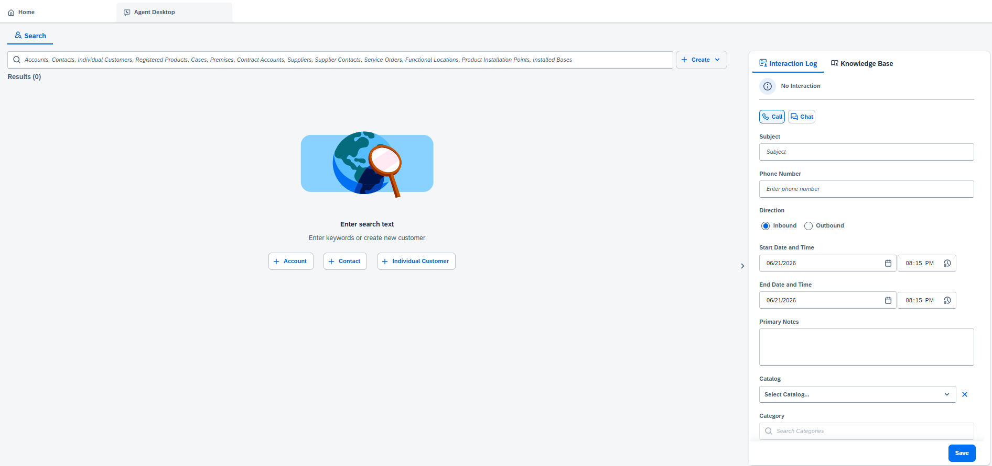
Live Agent Desktop
The agent desktop is the central work environment for an agent in SAP Service Cloud Version 2.
Review Knowledgebase articles
Search for Accounts, Contacts, Individual Customers, Cases, Premises, Contract Accounts, Service Orders, etc.
Create Case, Service Order
Log manual interactions
Create New Accounts, New Contacts, New Individual Customers

Slide 10
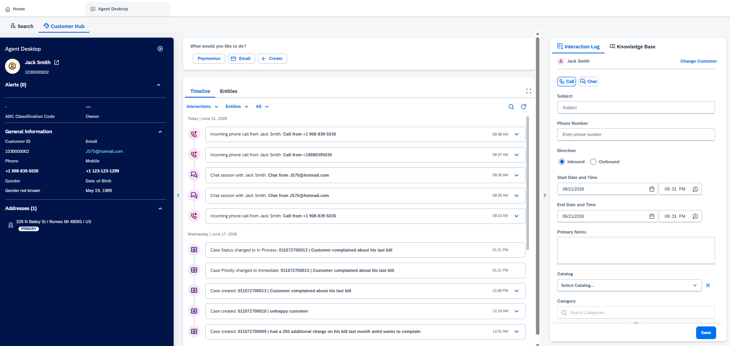
Agent Desktop – Customer Hub
Upon accepting an incoming call or chat request, customer hub opens automatically. If the interaction is from a known customer or contact, customer hub loads the relevant customer or contact information. The solution captures details of the interaction in the timeline.
Perform Key Actions like Make a payment, move in, move out, make a payment
Show Critical Alerts
Log manual interactions
The timeline shows phone calls, e-mail, chat interactions, cases, and other touch points with the customer.
Immediate view of customer header information

Slide 11
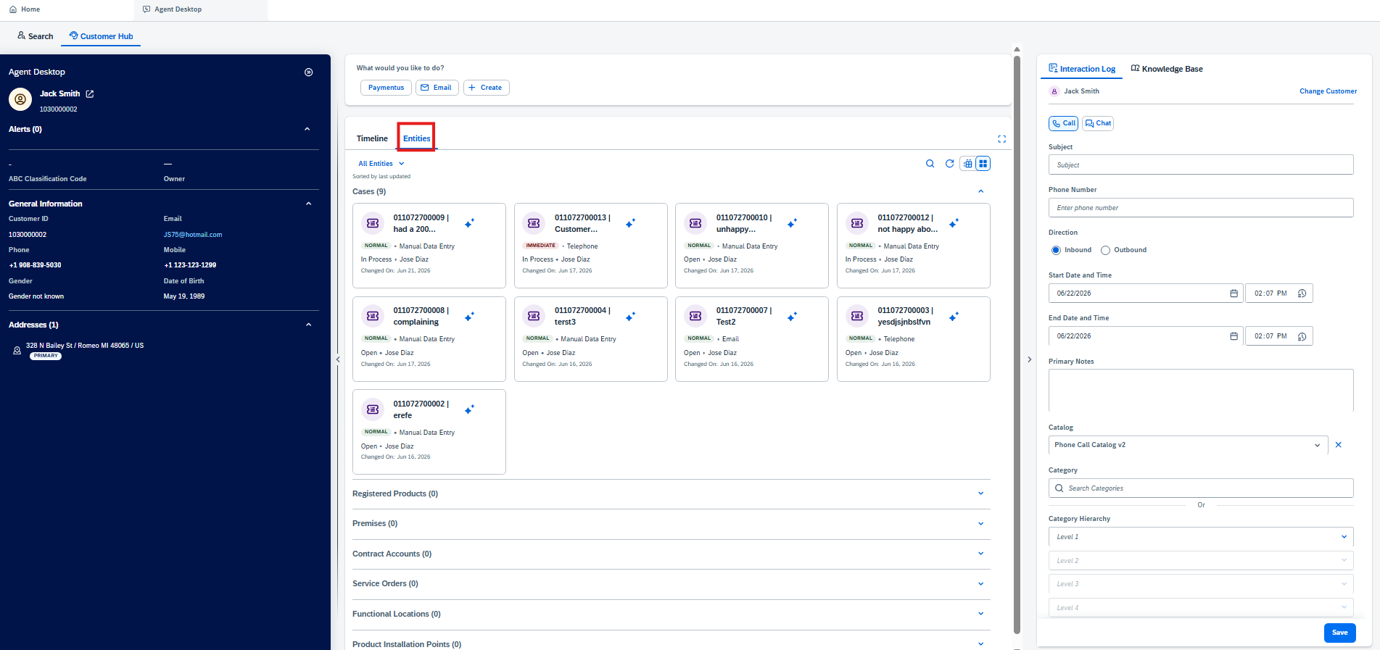
Agent Desktop – Customer Hub
View all related entities associated to the caller

Slide 12
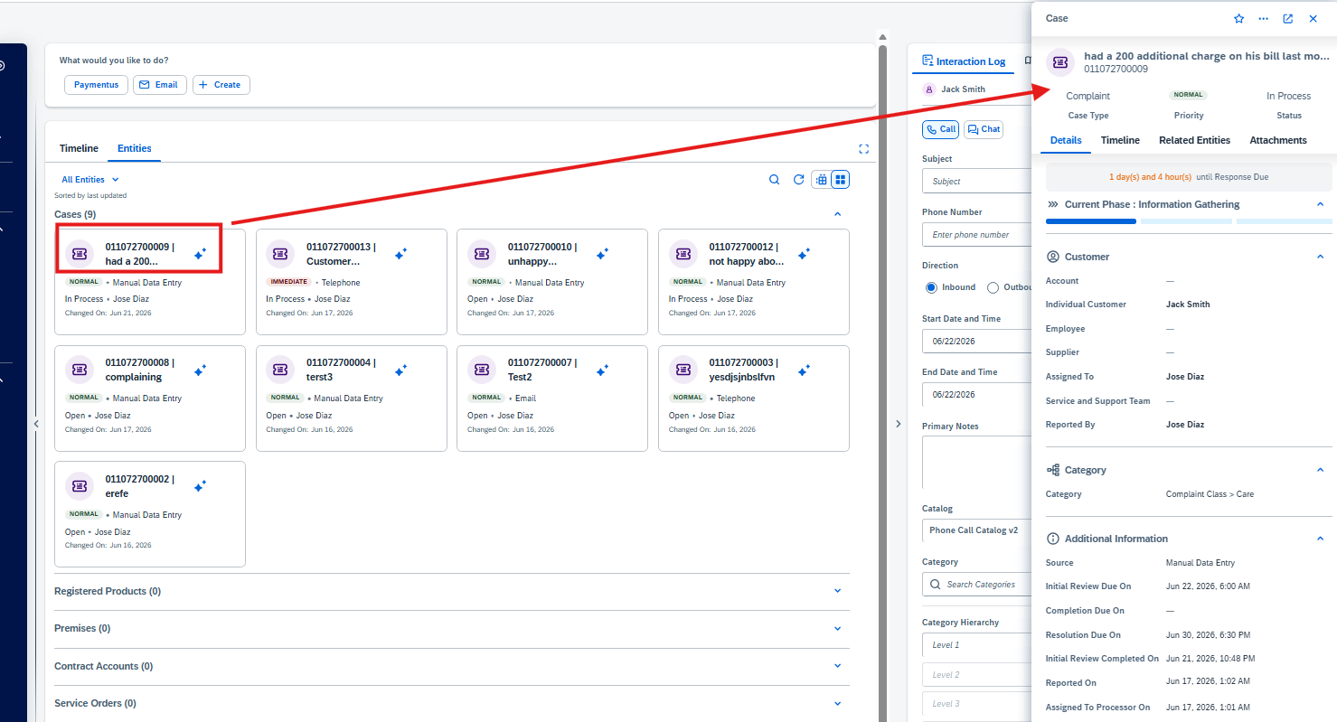
Agent Desktop – Customer Hub
Users can select an entity and get a quick view to the entity.
In this example, the quick view for a case is displayed, allowing the user to efficiently make changes to priority, status, and view SLA’s, related entities, and additional information.

Slide 13
What Is Changing In CTI Framing?
The current state is more than a widget. CRM7 has embedded UI plus event handling behavior directly in SAP
Current state evidence
SCv2 starting point
Workshop focus
CRM7 uses a Genesys Cloud experience, plus SAP Web UI and ABAP event handling.
Service Cloud v2 CTI configuration registers a provider hosted widget URL, outbound telephony, CAD/customer identification settings, and channels.
Validate whether the provider widget can reproduce CRM7 behaviors natively. Only introduce customizations via BTP where standard SCv2/provider widget falls short.

Slide 14
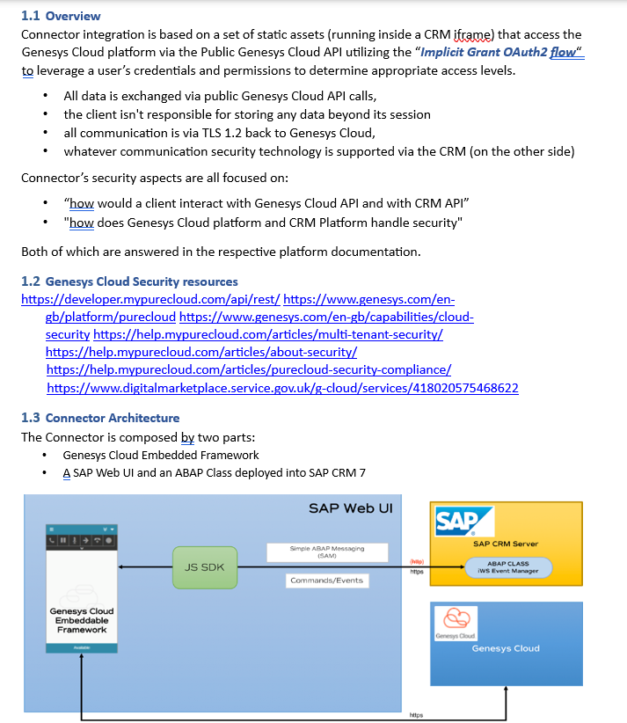
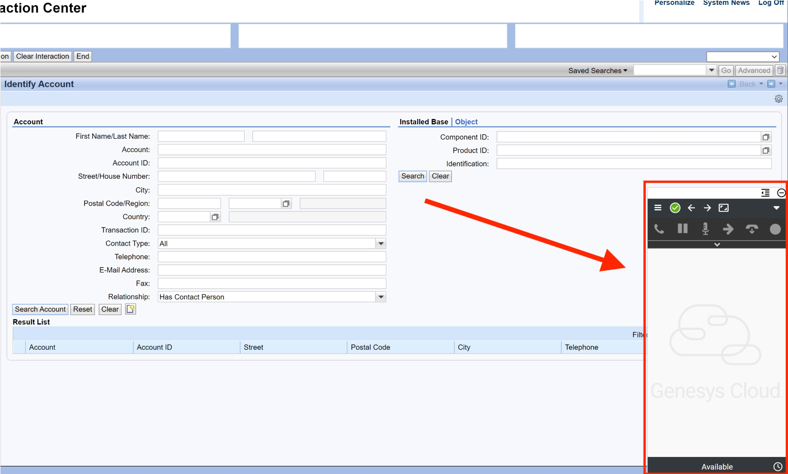
Genesys Integration Current State
Consumers currently has a CRM7 embedded Genesys Cloud connector where the Genesys widget runs inside the CRM browser session, while CRM7 side JavaScript and ABAP classes process Genesys events, execute screen-pop logic, create/open Interaction Records, and send CRM commands back to Genesys.
Standard Genesys Embedded Framework communication was not fully used because CRM7 was running over HTTP while Genesys Cloud required HTTPS. Voxai implemented a custom HTTP service to pass Genesys events and call context into CRM7 for screen pop, interaction handling, and CRM-side processing.

Slide 15
Genesys Integration Future State Options
Let’s start with the standard SCV2 CTI configuration and prove what the provider widget can do.
Service Cloud v2 Configuration
Provider Widget
Service Cloud v2 Reaction
Provider widget URL
Enable outbound telephony
Call Attached Data (CAD)
Screen pop rules
Enable telephony channel
Embedded inside the SCv2 (optional)
Receive telephony events from Genesys
Sends events to SAP CTI Adapter
Controls call UX (accept, reject, etc.)
Customer Hub pop
Phone activity and interaction logging
Timeline updates
Call Attached Data (CAD) display
Agent context
It’s essential the provider widget payloads are accurate for CTI to work.

Slide 16
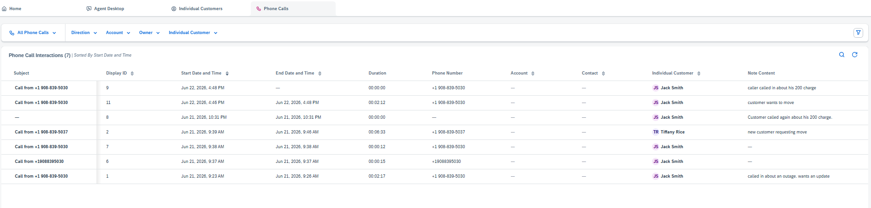
Phone Calls
Phone call interactions can be found in the Phone Calls work center where a user can view all content tied to the call.

Slide 17
Simulate CTI in Service Cloud v2
Scenarios
ANI Match to a unique customer
ANI Match to multiple customers
No ANI Match

Slide 18
BREAK! - 10 mins

Slide 19
03 Handle Call Process

Slide 20
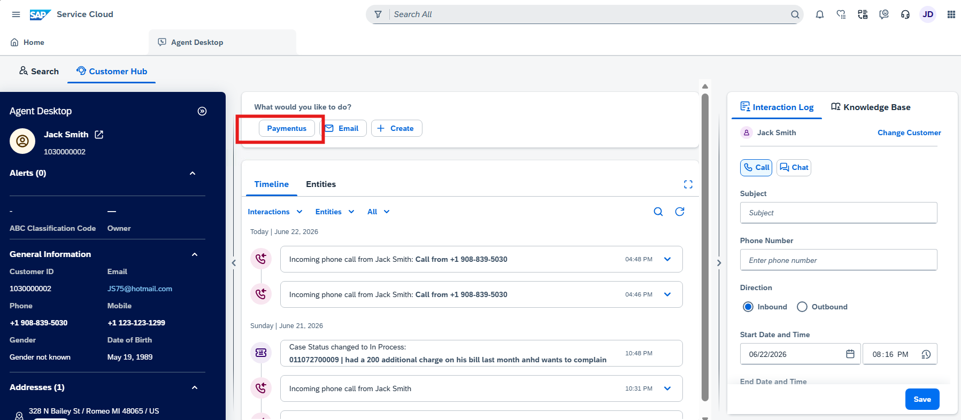
Paymentus
Paymentus will be an action seen as a individual button in the Agent Desktop once the customer is identified. Design discussions will need to include passing user roles and formatting a creating a specific token in the URL when launching the link to Paymentus.

Slide 21
Energy Use Dashboard
Energy Use Dashboard will be available as another action in the customer hub

Slide 22
04 Alerts

Slide 23
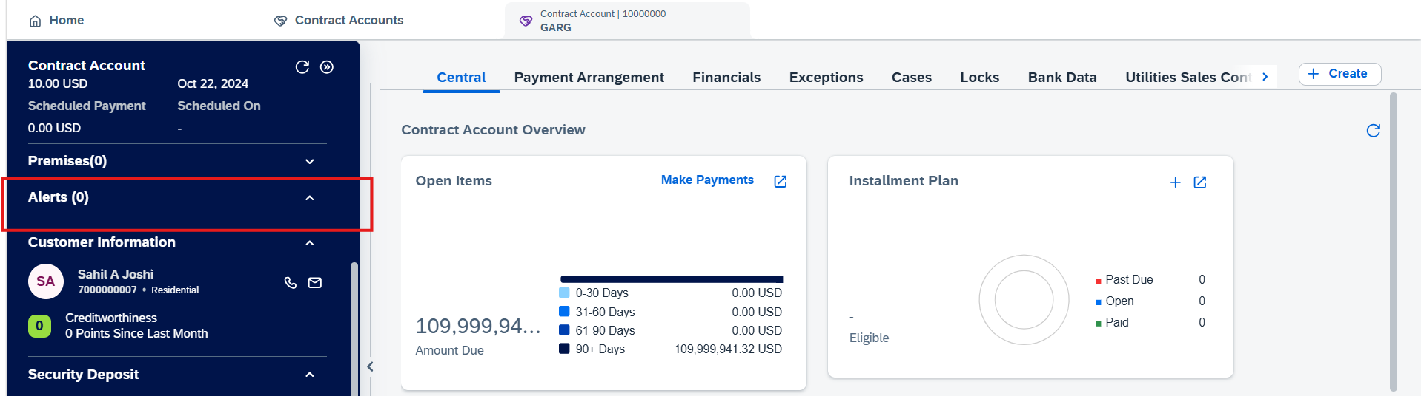
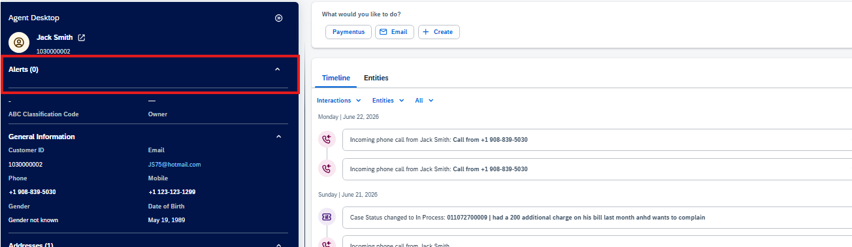
Alerts
Alerts can be found on the header level of the Customer Hub, Contract Account, and Premise objects

Slide 24
05 Assumptions for Future State

Slide 25
Key Assumptions
Outbound Calls and Chat capabilities will continue to exist in Genesys Cloud
If no phone number matches the caller, the IVR will try to verify based on the account number.
Voxai team can pass key fields required for SQM reporting in one of the 4 CAD fields
Implementation team will assess the feasibility of migrating over 10 years worth of interactions and notes

Slide 26
06 FRICE-W

Slide 27
FRICE-W Identified
Live Agent Desktop field enhancement – May not be needed
Timeline events placeholder
Paymentus Integration
Energy Use Dashboard Interface
Customer Hub Alerts
Contract Account Alerts
Premise Alerts
Move In Alerts
Move Out Alerts
CXI Survey placeholder

Slide 28
07 Drafted User Stories

Slide 29
User Stories for Manage Contact History
Please note, this is just a drafted starting point we will leverage to formulate our actual user stories and acceptance criteria
L1 | L2 | L3 | L4 | User Story | Acceptance Criteria
Manage Customer Service | Manage Contact History | Live Agent Desktop | Live Agent Desktop | As an SAP Customer Service Agent, I want to efficiently manage customer contact history within the Live Agent Desktop so that I can access recent interactions, capture new details, and provide timely, consistent support during active engagements. | 1. Able to view customer contact history within the Live Agent Desktop. 3.Able to record new interaction details in the Live Agent Desktop. 4.Able to update existing contact notes in the Live Agent Desktop. 5.Able to search recent interactions within the Live Agent Desktop. 6.Able to link interactions to the current engagement in the Live Agent Desktop. 7.Able to save changes to contact history from the Live Agent Desktop. 8.Able to view the latest interaction timestamp in the Live Agent Desktop. 9.Able to build Security roles and perform testing. 10.Able to identify Risk and Controls
Manage Customer Service | Manage Contact History | Handle Call Process | Handle Call Process | As an SAP Customer Service Representative, I want to handle call process within Manage Contact History so that customer interactions are consistently managed and traceable in the Manage Customer Service application. | 1. Able to access Manage Contact History during the Handle Call Process. 3.Able to view existing contact history while handling the call process. 4.Able to update contact history during the Handle Call Process. 5.Able to complete the Handle Call Process in Manage Customer Service. 6.Able to track customer interactions during the Handle Call Process. 7.Able to confirm traceability of the Handle Call Process in contact history. 8.Able to locate the Handle Call Process entry in contact history. 9.Able to build Security roles and perform testing. 10.Able to identify Risk and Controls
Manage Customer Service | Manage Contact History | Alerts / Highlights | Alerts / Highlights | As an SAP Customer Service Representative, I want Alerts / Highlights within Manage Contact History so I can quickly identify important customer interactions and address urgent issues during service activities. | 1. Able to view all Alerts in the contact history. 3.Able to view all Highlights in the contact history. 4.Able to distinguish Alerts from Highlights in the contact history view. 5.Able to open an individual Alert from the contact history. 6.Able to open an individual Highlight from the contact history. 7.Able to see the contact history entry when viewing an Alert. 8.Able to see the contact history entry when viewing a Highlight. 9.Able to build Security roles and perform testing. 10.Able to identify Risk and Controls

Slide 30
08 Decisions, Action Items, Change Impacts, Wrap-Up & Next Steps

Slide 31
Program Charging (CE Internal Only)
The Change & Why:
We need to track O&M costs more precisely. OCM and Data Conversion must be charged separately from End User Training and from Design/Build/Deployment work. This change is retroactive from February for Accounting, Rate case discovery, and audit.
Ask:
Pls follow the instructions below that apply to you based on your staffing category on the LaunchPad program. It is critical to track costs in the correct cost buckets.
Business Partner (BP) Core Team (Use SAP*):
Continue 100% allocation as before. (BP&A handles this automatically behind the scenes and no time entry is needed except for the two scenarios below)
Submit time only for OCM and Data Conversion activities; Use SAP to bill IO 6520973.
Submit time only for End User Training; Use SAP to bill IO 6519532.
IT Core Team (Use Clarity):
S4- Customer – Design/Development/Testing/Deploy Clarity Task
Clarity Timesheets will now be used for time charging, and the allocation mechanism is discontinued. Submit timesheets from February 2nd for a one-time catchup.
Separate tasks for OCM, End User Training, and Data Conversion are available; Find them using keywords OCM, End User Training, and Data Conversion and charge them as applicable.
Extended BP Team (use SAP*):
Bill SAP IO 6520973 for OCM and Data Conversion.
Bill SAP IO 6519532 for End User Training.
Use new IO 6521411 for all other tasks.
Extended IT Team (Use Clarity):
S4- Customer – Design/Development/Testing/Deploy Clarity Task
Bill specific tasks for OCM, End User Training, and Data Conversion; ID the tasks using the keywords OCM, End User Training, and Data Conversion.
Bill other tasks as appropriate.
*SAP Timesheet Submission Instructions (for BPs)
Follow ESS steps (screen shot below): 1. Open ESS timesheet. 2. Enter IO number in work order field. 3. Select WORK code under ATT-ABS. 4. Add OCM, End User Training, or Data Conversion in comments. 5. Enter hours worked.

